Slide 1

RESECTIVE OSSEOUS SURGERY
RUNGTA COLLEGE OF DENTAL SCIENCES AND RESEARCH,BHILAI
PRESENTED BY:
Dr Sonika Bodhi
Reader
Dept. of Periodontology

Slide 2
SPECIFIC LEARNING OBJECTIVES
Core areas | Domain | Category
Introduction | Affective | Desire to know
Rationale | Cognitive | Nice to know
Normal alveolar bone morphology | Cognitive | Must to know
Terminology | Cognitive | Must to know
Factors in selection of technique | Cognitive | Must to know
Examination , diagnosis and treatment planning | Cognitive | Must to know
Techniques | Cognitive | Must to know
Specific situations | Affectice | Nice to know

Slide 3
CONTENTS
Introduction
Rationale
Normal alveolar bone morphology
Terminology
Factors in selection of technique
Examination , Diagnosis and Treatment Planning
Techniques
Specific situations
Summary
References

Slide 4
INTRODUCTION
Bony deformities .....resulting from periodontal disease...... are not uniform;
They may be
  Horizontal bone loss,
  Vertical bone loss or
  combination

Slide 5
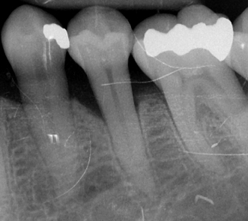
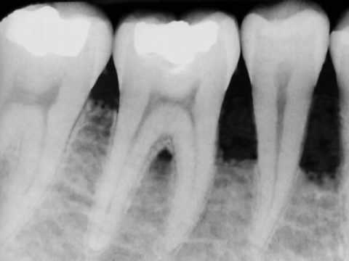

Slide 6
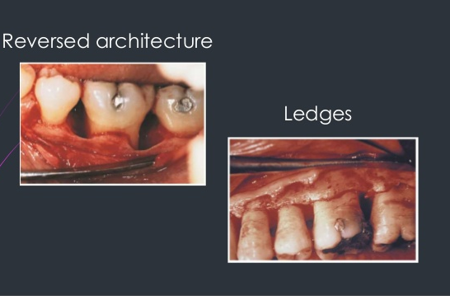

Slide 7
Horizontal bone loss generally results in a relative thickening of the marginal alveolar bone, because bone tapers as it approaches its most coronal margin.
To provide a more physiologic bone pattern, a method for osseous recontouring must be followed.

Slide 8
RATIONALE
The goal of osseous resective therapy is to reshape the marginal bone to resemble that of the alveolar process undamaged by periodontal disease.
The technique is performed in combination with apically positioned flaps, and the procedure eliminates periodontal pocket depth and improves tissue contour to provide a more easily maintainable environment.

Slide 9
NORMAL ALVEOLAR BONE MORPHOLOGY
1. The interproximal bone is more coronal in position than the labial or lingual/palatal bone and pyramidal in form.
Notes:
The characteristics of a normal bony form are as follows

Slide 10
2. The form of the interdental bone is a function of the tooth form and the embrasure width.
The more tapered the tooth, the more pyramidal is the bony form.
The wider the embrasure, the more flattened is the interdental bone mesiodistally and buccolingually

Slide 11
3. The position of the bony margin mimics the contours of the cementoenamel junction.
The molar teeth have less scalloping and a more flat profile than bicuspids and incisors
Teeth with prominent roots or those displaced to the facial or lingual side may also have fenestrations or dehiscences.

Slide 12
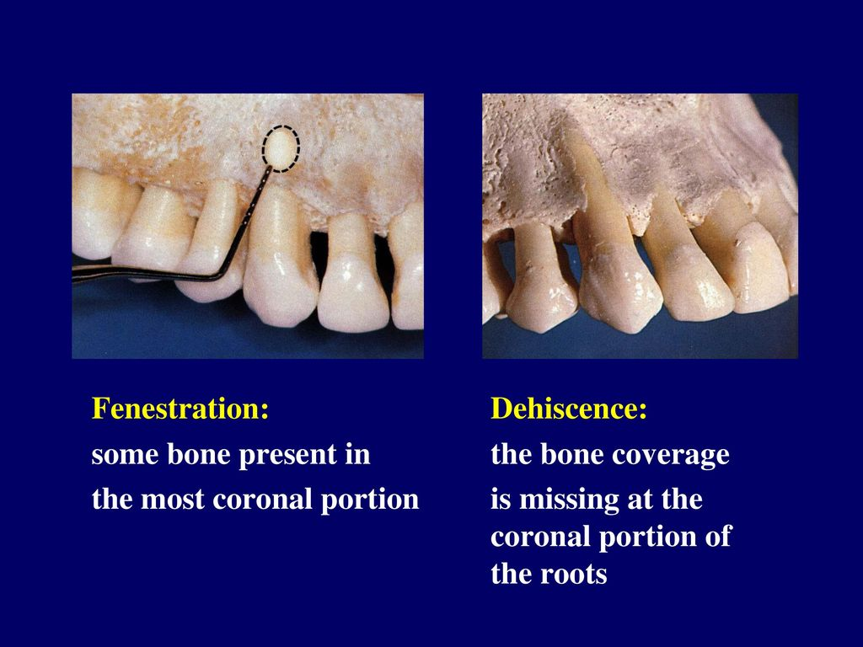

Slide 13
TERMINOLOGY
OSSEOUS SURGERY .............the procedure by which changes in the alveolar bone can be accomplished to rid it of deformities induced by the periodontal disease process or other related factors, such as exostosis and tooth supraeruption.

Slide 14
Additive osseous surgery includes procedures directed at restoring the alveolar bone to its original level.
Subtractive osseous surgery is designed to restore the form of preexisting alveolar bone to the level present at the time of surgery or slightly more apical to this level.
Notes:
Additive osseous surgery brings about the ideal result of periodontal therapy; it implies regeneration of lost bone and reestablishment of the periodontal ligament, gingival fibers, and junctional epithelium at a more coronal level

Slide 15
OSTEOPLASTY: defined as a procedure by which nonsupporting bone is reshaped to achieve a physiologic gingival and osseous contour.
OSTECTOMY: is the removal of radicular and interradicular supporting bone to eliminate osseous deformities.

Slide 16
Definitive osseous reshaping implies that further osseous reshaping would not improve the overall result.
Compromise osseous reshaping indicates a bone pattern that cannot be improved without significant osseous removal that would be detrimental to the overall result.

Slide 17
The architecture is said to be “positive” if the radicular bone is apical to the interdental bone.
The bone is said to have “negative” architecture if the interdental bone is more apical than the radicular bone.
Flat architecture is the reduction of the interdental bone to the same height as the radicular bone.

Slide 18
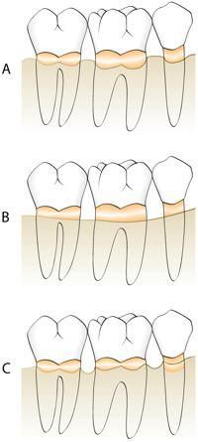
Notes:
A, Positive bony architecture. B, Flat bony architecture. C, Reversed, or negative, bony form

Slide 19
Osseous form is considered to be “ideal” when the bone is consistently more coronal on the interproximal surfaces than on the facial and lingual surfaces.
The ideal form of the marginal bone has similar interdental height, with gradual, curved slopes between interdental peaks.

Slide 20
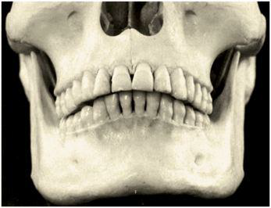

Slide 21
FACTORS IN SELECTION OF RESECTIVE OSSEOUS SURGERY
early to moderate bone loss (2-3 mm) with moderate-length root trunks that have bony defects with one or two walls.
These shallow to moderate bony defects can be effectively managed by osteoplasty and osteoectomy

Slide 22
Contraindicated in patients with advanced attachment loss and deep intrabony defects

Slide 23
EXAMINATION AND TREATMENT PLANNING
Periodontal probing and exploration are key aspects of the examination.
Careful probing reveals the presence of
pocket depth greater than that of a normal gingival sulcus,
the location of the base of the pocket relative to the mucogingival junction and attachment level on adjacent teeth,
the number of bony walls, and
the presence of furcation defects

Slide 24
Transgingival probing, or sounding, under local anesthesia confirms the extent and configuration of the intrabony component of the pocket and of furcation defects

Slide 25
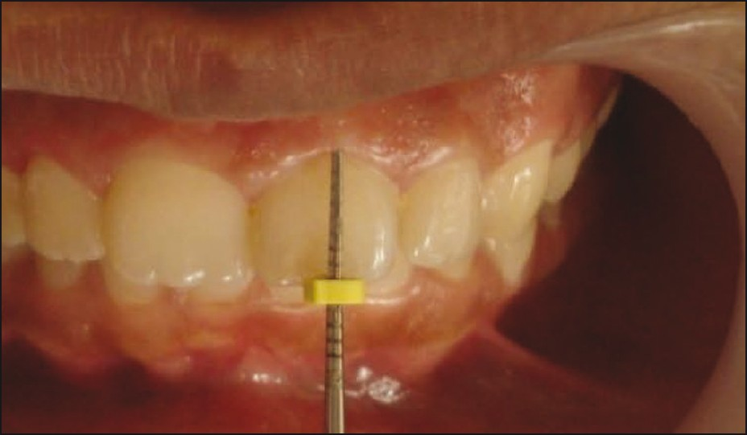
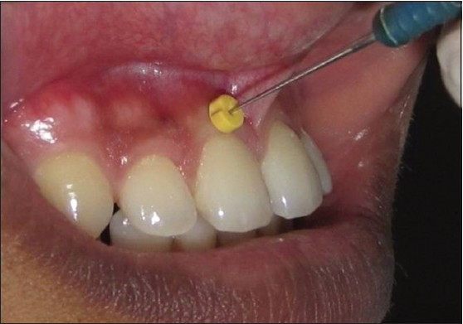

Slide 26
OSSEOUS RESECTION TECHNIQUE
Instrumentation
Rotary instruments .........osteoplasty procedures
Hand instruments .......... ostectomy procedures.

Slide 27
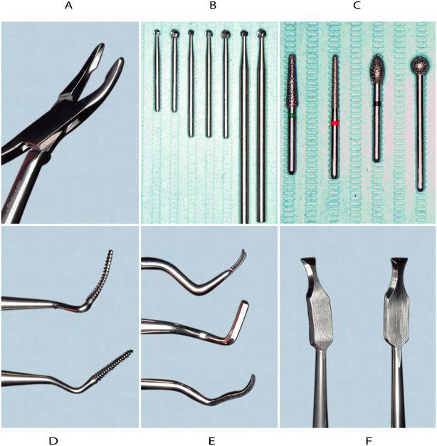
Notes:
Rongeurs: Friedman (top) and 90-degree Blumenthal (bottom). B, Carbide round burs. Left to right, Friction grip, surgical-length friction grip, and slow-speed handpiece. C, Diamond burs. D, Interproximal files:Schluger and Sugarman.E, Back-action chisels. F, Ochsenbein chisels

Slide 28
sequential steps are suggested for resective osseous surgery
Vertical grooving
Radicular blending
Flattening interproximal bone
Gradualizing marginal bone

Slide 29
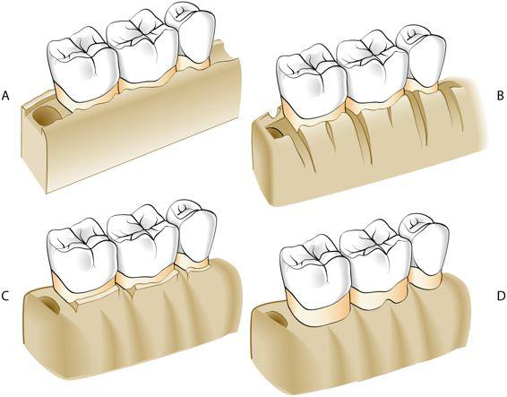
Notes:
Drawing of bony topography in moderate periodontitis with interdental craters. B, Vertical grooving, the first step in correction by osseous reshaping. C, Radicular blending and flattening of interproximal bone. D, Gradualizing the marginal bone. Note the area of the furcation on the first molar where the bone is preserved.

Slide 30
VERTICAL GROOVING
It is the first step
It defines the general thickness and subsequent form of the alveolar housing
It also provides continuity from the interproximal surface onto the radicular surface.
This step is usually performed with rotary instruments, such as round carbide burs or diamonds

Slide 31
The advantages of vertical grooving are most apparent with thick bony margins, shallow crater formations, or other areas that require maximal osteoplasty and minimal ostectomy.
Vertical grooving is contraindicated in areas with close roots or thin alveolar housing.

Slide 32
RADICULAR BLENDING
Second step of the osseous reshaping technique and is an extension of vertical grooving
Conceptually, it is an attempt to gradualize the bone over the entire radicular surface to provide the best results from vertical grooving.
This provides a smooth, blended surface for good flap adaptation

Slide 33
The indications are the same as for vertical grooving (i.e., thick ledges of bone on the radicular surface, where selective surgical resection is desired).
Naturally, this step is not necessary if vertical grooving is very minor or if the radicular bone is thin or fenestrated

Slide 34
FLATTENING INTERPROXIMAL BONE
Flattening of the interdental bone requires the removal of very small amounts of supporting bone.
It is indicated when interproximal bone levels vary horizontally.
By definition, most of the indications for this step are one-walled interproximal defects or hemiseptal defects

Slide 35
The omission of flattening in such cases results in increased pocket depth on the most apical side of the bone loss.
This step is typically not necessary with inter-proximal crater formations or flat interproximal defects.

Slide 36
GRADUALIZING MARGINAL BONE
Bone removal is minimal but necessary to provide a sound, regular base for the gingival tissue to follow.
Failure to remove small bony discrepancies on the gingival line angles (widow's peaks) allows the tissue to rise to a higher level than the base of the bone loss in the interdental area.

Slide 37
This may make the process of selective recession and subsequent pocket reduction incomplete.
This step of the procedure also requires gradualization and blending on the radicular surface.

Slide 38
The two ostectomy steps should be performed with great care so as not to produce nicks or grooves on the roots.
Not required....When the radicular bone is thin.
chisels and curettes are preferred

Slide 39
FLAP PLACEMENT AND CLOSURE
Flaps may be replaced to their original position, to cover the new bony margin, or they may be apically positioned.
Replacing the flap in areas that previously had deep pockets may result initially in greater postoperative pocket depth, although a selective recession may diminish the depth over time.

Slide 40
The sutures should be placed with minimal tension to coapt the flaps, prevent their separation, and maintain the position of the flaps.

Slide 41
POSTOPERATIVE MAINTENANCE
Nonresorbable sutures such as silk are usually removed after 1 week of healing, although some of the newer synthetic materials may be left for up to 3 weeks or longer without adverse consequences

Slide 42
Resorbable sutures maintain wound approximation for varying periods of 1 to 3 weeks or more, depending on the type of suture material.

Slide 43
At the suture removal appointment the periodontal dressing, if present, is removed, and the surgical site is gently cleansed of debris with a cotton pellet dampened with saline. Nonresorbable sutures are then cut and removed.
post-surgical maintenance instructions are given

Slide 44
A second postoperative visit is often performed at the second or third week, and the surgical site is lightly debrided for optimal results.
Healing should proceed uneventfully, with the attachment of the flap to the underlying bone completed in 14 to 21 days. Maturation and remodeling can continue for up to 6 months.

Slide 45
It is usually advisable to wait at least 6 weeks after completion of healing of the last surgical area before beginning dental restorations.

Slide 46
SPECIFIC OSSEOUS RESHAPING SITUATIONS
Correction of one-walled hemiseptal defects requires that the bone be reduced to the level of the most apical portion of the defect. Therefore, great care should be taken to select the appropriate case.
If one-walled defects occur next to an edentulous space, the edentulous ridge is reduced to the level of the osseous defect.

Slide 47
Summary
Osseous surgery can eliminate and modify defects, as well as gradualize excessive bony ledges, irregular alveolar bone, early furcation involvement, excessive bony exostosis, and circumferential defects. When properly performed, resective osseous surgery achieves a physiologic architecture of marginal alveolar bone conducive to gingival flap adaptation with minimal probing depth.

Slide 48
References
Newman MG, Takei HH, Klokkevold PR, Carranza FA. Carranza’s clinical periodontology, 10th ed. Saunders Elsevier; 2007.
Lindhe J, Lang NP and Karring T. Clinical Periodontology and Implant Dentistry. 6th ed. Oxford (UK): Blackwell Publishing Ltd.; 2015.
Newman MG, Takei HH, Klokkevold PR, Carranza FA. Carranza’s clinical periodontology, 13th ed. Saunders Elsevier; 2018.

